Slide 1
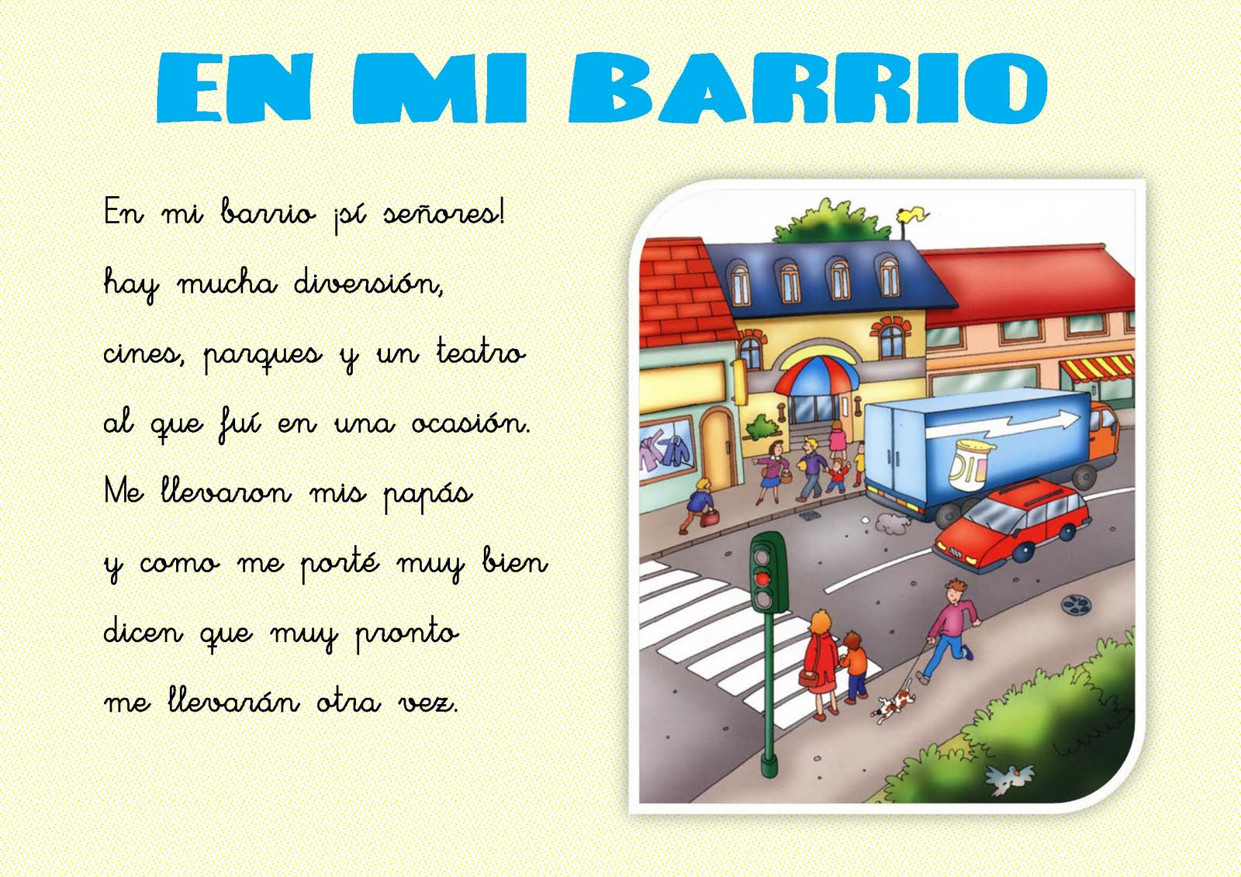
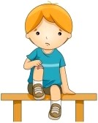
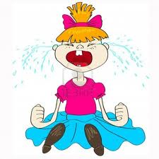
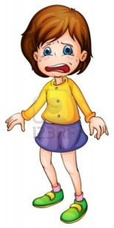

Slide 2
How do these people feel? Match a word in the box with a person in the picture. Take turns tellinh your pather
Feellings
Happy .
Bored .
Angry
Nervous .
Sad .
Scared.
Embarrased
1.The man in the red coat is nervous.
2. The boy in the blue t- shirt is bored.
B. Look at the picture again. What are the people doing complete the sentences. Use the correct form of the verbs in the box.
Smile laugh yell blush cry frown
1. What is the man in the red coat doing?
the man in the red coat is smiling
2. What is the boy in the blue t-shirt doing?
The boy in the blue t- shirt is crying
3. What is the man the blond hair doing?
The man the blond hair is laughing
4. What is the girl in the yellow t- shirt doing?
The girl in the yellow t-shirt is frowning
5. What is the girl in the pink t-shirt doing?
The girl in the pink t-shirt is yelling.
3. The man the blond hair is happy.
4. The girl in the yellow t-shirt is scared.
5. The girl in the pink t-shirt is sad.

